Slide 1

Embedded System Applications
Wireless Home Automation Systems

Slide 2

Need of Home Automation
Home automation refers to the use of computer and information technology to control home appliances and features (such as windows or lighting).
It is the residential extension of building automation. It is automation of the home, housework or household activity.
Home automation for the elderly and disabled can provide increased quality of life for persons who might otherwise require caregivers or institutional care.
The popularity of home automation has been increasing greatly in recent years due to much higher affordability and simplicity through smartphone and tablet connectivity.

Slide 3
About Home Automation System
A typical wireless home automation system allows one to control household appliances from a centralised control unit which is wireless. These appliances usually have to be specially designed to be compatible with each other and with the control unit for most commercially available home automation systems.
The project demonstrates a system that can be integrated as a single portable unit and allows one to wirelessly control lights, fans, air conditioners, television sets, security cameras, electronic doors, computer systems, audio/visual equipment’s etc. and turn on or off any appliance that is plugged into a wall outlet, etc.
It also provides energy saving, graphical user interface or HMI and security to the homes.

Slide 4
Project Requirements
Arduino UNO
LED strips
Resistor
Voltage regulator
AC Adapter
Bluetooth module(HC-05)
Android app(Blue SPP)
Terminals
2-Wire PC fan
Transistor Switch(npn)

Slide 5
Major Components ARDUINO UNO BOARD
The Arduino Uno is a microcontroller board based on the ATmega328.
It has 14 digital input/output pins (of which 6 can be used as PWM outputs), 6 analog inputs, a 16 MHz crystal oscillator, a USB connection, a power jack, an ICSP header, and a reset button.
It contains everything needed to support the microcontroller; simply connect it to a computer with a USB cable or power it with a AC-to-DC adapter or battery to get started.
The Arduino Uno can be powered via the USB connection or with an external power supply

Slide 6
FEATURES
Microcontroller :ATmega328
Operating Voltage :5V
Input Voltage (recommended) :7-12V
Input Voltage (limits) :6-20V
Digital I/O Pins :14 (of which 6 provide PWM output)
Analog Input Pins :6
DC Current per I/O Pin :40 MA
DC Current for 3.3V Pin :50 MA
Flash Memory :32 KB (ATmega328) of which 0.5 KB used by bootloader
SRAM :2 KB (ATmega328)
EEPROM :1 KB (ATmega328)
Clock Speed :16 MHz

Slide 7
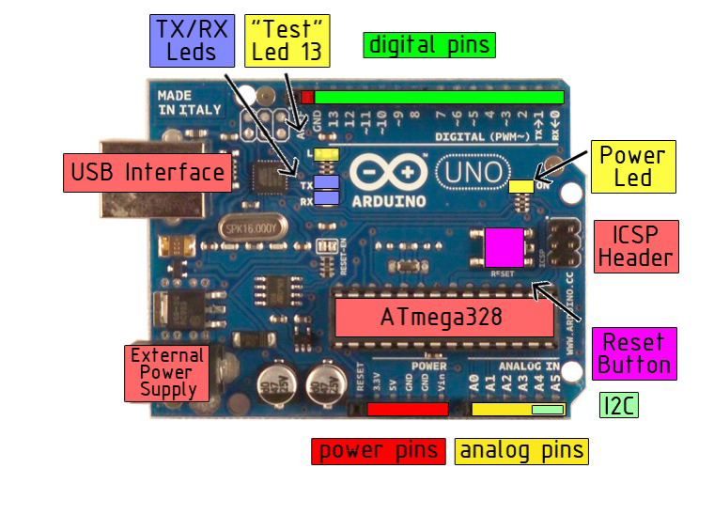
The Arduino Board

Slide 8

Serial Port Bluetooth Module(Master/Slave) : HC-05
HC-05 module is an easy to use Bluetooth SPP (Serial Port Protocol) module, designed for transparent wireless serial connection setup.
The easiest & economical way to go wireless in an Embedded project is through a Bluetooth module.
It has the footprint as small as 12.7mmx27mm. Hope it will simplify your overall design/development cycle.
HC05 model can be configured either for a Master or for a Slave mode , thus most preferred for a Microcontroller project.
The Bluetooth protocol operates at 2.4GHz in the same unlicensed ISM frequency band where RF protocols like ZigBee and WiFi also exist.

Slide 9
Features of Bluetooth Module(Master/Slave) : HC-05
Hardware Features
Typical -80dBm sensitivity
Up to +4dBm RF transmit power
Low Power 1.8V Operation ,5V
PIO control
UART interface with programmable baud rate
With integrated antenna
With edge connector

Slide 10
Software Features
Default Baud rate: 38400, Data bits:8, Stop bit:1,Parity:No parity, Data control: has.
Supported baud rate: 9600,19200,38400,57600,115200,230400,460800.
Given a rising pulse in PIO0, device will be disconnected.
Status instruction port PIO1: low-disconnected, high-connected;
PIO10 and PIO11 can be connected to red and blue led separately. When master and slave are paired, red led blinks 1time/2s in interval, while disconnected red led blinks 2times/s.
Auto-connect to the last device on power as default.
Permit pairing device to connect as default.
Auto-pairing PINCODE:”0000” as default
Auto-reconnect in 30 min when disconnected as a result of beyond the range of connection

Slide 11
AC ADAPTER
An AC adapter, AC/DC adapter, or AC/DC converter is a type of external power supply, often enclosed in a case similar to an AC plug.
AC adapters are used with electrical devices that require power but do not contain internal components to derive the required voltage and power from mains power.

Slide 12
TRANSISTOR
One of the most fundamental applications of a transistor is using it to control the flow of power to another part of the circuit – using it as an electric switch.
Driving it in either cutoff or saturation mode, the transistor can create the binary on/off effect of a switch.
Transistor switches are critical circuit-building blocks; they’re used to make logic gates, which go on to create microcontrollers, microprocessors, and other integrated circuits.

Slide 13
2-WIRE PC FAN
These are the oldest and most simple PC fans. Only two wires comes out out of the fan controller, the positive and the negative. Giving power to the fan, it will rotate at full speed.
The connector of a 2-wire fan has a red and a black cable. The red cable goes to the positive of the power supply and the black to the negative.
Usually, for more flexibility, they have a male-female 4- wire molex power connector.

Slide 14
VOLTAGE REGULATOR
A voltage regulator is designed to automatically maintain a constant voltage level.
A voltage regulator may be a simple "feed-forward" design or may include negative feedback control loops.
Depending on the design, it may be used to regulate one or more AC or DC voltages.
The voltage regulator is needed to keep voltages within the prescribed range that can be tolerated by the electrical equipment using that voltage.

Slide 15
RESISTORS
Resistors are the most commonly used component in electronics and their purpose is to create specified values of current and voltage in a circuit.
The unit for measuring resistance is the OHM. (the Greek letter Ω - called Omega). Higher resistance values are represented by "k" (kilo-ohms) and M (mega ohms).
Resistance value is marked on the resistor body. Most resistors have 4 bands. The first two bands provide the numbers for the resistance and the third band provides the number of zeros. The fourth band indicates the tolerance. Tolerance values of 5%, 2%, and 1% are most commonly available.

Slide 16
Schematic Diagram

Slide 17
Working
This project aims in designing a circuit which controls a led strip and a cpu fan using an android mobile phone. The controlling of the circuit is done wirelessly through android smart phone using the bluetooth feature present in it. Here in the project the android smart phone is used as a remote control for operating the led strip and the fan.
The controlling device of the whole system is a microcontroller. Bluetooth module, switches of led strip and fan are interfaced to the microcontroller. The data received by the bluetooth module from Android smart phone is fed as input to the controller. The controller acts accordingly on the switches of the led strip and the fan. The led strip and the fan in the project can be made to turn on and off using the android phone. In achieving the task the controller is loaded with a program written using Embedded ‘C’ language.

Slide 18
CODE USED IN THE PROJECT :
#define LED 2
#define FAN 3
char incomingByte;
// the setup routine runs once when you press reset:
void setup()
{
// initialize the digital pin as an output.
Serial.begin(9600);
Serial.println("Program Started");
pinMode(LED, OUTPUT); pinMode(FAN, OUTPUT);
digitalWrite(LED, LOW); digitalWrite(FAN, LOW);
}

Slide 19
void serialFlush(){
while(Serial.available() > 0) {
char t = Serial.read();
}
}
// the loop routine runs over and over again forever:
void loop()
{
if (Serial.available() > 0)
{
incomingByte = Serial.read();
if(incomingByte == 'A') // led on
{
Serial.println("LED ON");
digitalWrite(LED, HIGH)

Slide 20
}
else if(incomingByte == 'B') // led off
{
Serial.println("LED OFF");
digitalWrite(LED, LOW);
}
else if(incomingByte == 'C') // Fan on
{
Serial.println("FAN ON");
digitalWrite(FAN, HIGH);
}
else if(incomingByte == 'D') // FAN off
{
Serial.println("FAN OFF");
digitalWrite(FAN, LOW);
}
}
delay(100);
}

Slide 21
CIRCUITRY OF THE PROJECT

Slide 22
Conclusion
This low cost system is designed to improve the standard living in home. The remote control function by smart phone provides help and assistance especially to disabled and elderly.
In order to provide safety protection to the user, a low voltage activating switch is replaced by current electrical switch.
Implementation of wireless Bluetooth connection in control board allows the system install in more simple way.
The easy to use interface on Window and Android GUI provides simple control by the elderly and disabled people.

Slide 23
Prepared By : Mrigya Jain Nidhi Dogra Vasundhra Dabas Pratishtha Kumar

